Slide 1
Facing the Lisbon earthquake:
The problem of evil and the birth of ‘natural’ disaster
Come, ye philosophers, who cry “All’s well,”
And contemplate this ruin of a world.
-Voltaire

Slide 2
How can we explain the existence of evil?
Azande:

Slide 3
Evil (in Old English)
Both misfortune and moral wickedness
”Evil was the word Anglo-Saxons used where we would use bad, cruel, unskillful, defective (adj.), or harm, crime, misfortune, disease (n.).”
-Online Etymology dictionary
Anything, either moral of physical , that caused injury could be called an 'evil'--diseases or maladies in particular were considered 'evils.'

Slide 4
Middle English
Bad -→ takes most of the meanings associated with misfortune, injury, etc.
Evil begins to focus on ‘moral badness’

Slide 5
18th century
Only in 1700s was the word ‘evil’ restricted to the meaning of “extreme moral wickedness” that we associate with it today

Slide 6
Natural evil and moral evil
Today we carefully distinguish natural ‘bads’ from moral ‘evils’
But if this distinction appeared in the 18th century, how did it happen?
And what are the consequences of this distinction?

Slide 7
18th Century
Enlightenment
“emergence from self-incurred immaturity. Immaturity is the inability to use one’s understanding without the guidance of another.”-Immanuel Kant, “What is enlightenment?”, 1784
Colonialism
Aftermath of reformation and religious wars between Protestants and Catholics

Slide 8
The central question:
How could a good God create a world full of innocent suffering?
If we accept that God is all-powerful and created the universe, and there is innocent suffering in the universe, does this mean God is evil? If not, how do we explain this suffering?

Slide 9
1. Blame the sufferers
Joachim Patinir, The Destruction of Sodom and Gomorra, 1520

Slide 10
Sin (moral evil) → Suffering (natural evil)

Slide 11
Gottfried Leibniz
2. THEODICY

Slide 12
What is ‘theodicy’?
A philosophical defense of God against the accusation that God could be evil.
Gottfried Leibniz, 1646-1716

Slide 13
First defense: interconnections of causes
Could there be a more perfect world?
But if you remove this unfortunate event, how do you know how this would change other aspects of the world? Can you be sure that overall things would be better?

Slide 14
Second defense: Good for who?
Human standard
What about other sentient beings?
What about beings on possible other planets?

Slide 15
Best of all possible worlds
Although evil things do happen, an all-knowing, all-powerful God chose this world out of all of the (infinite) possible worlds--

Slide 16
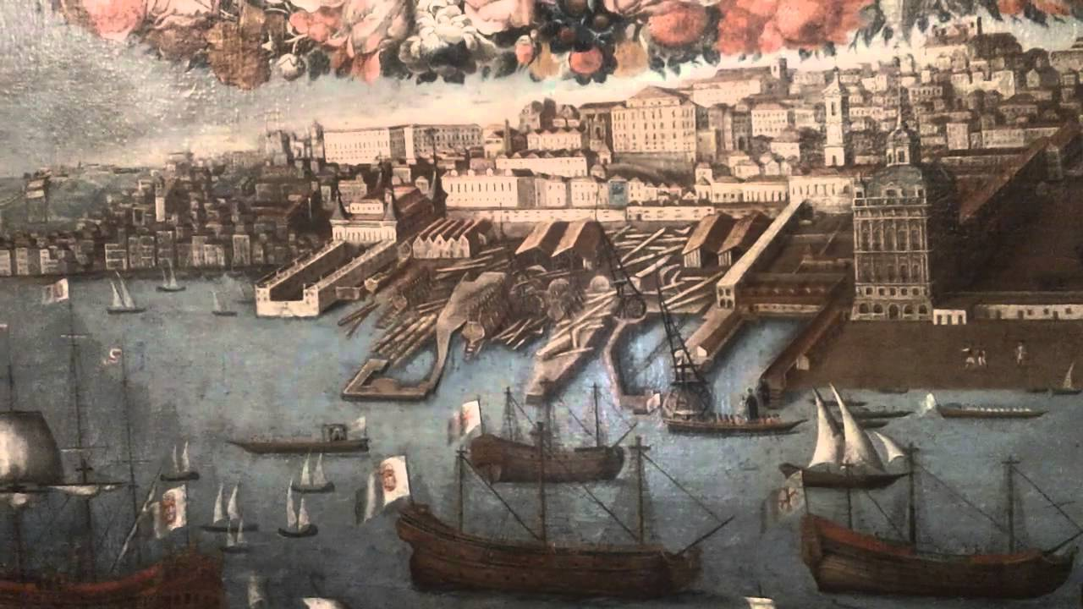
Lisbon, 17th century

Slide 17
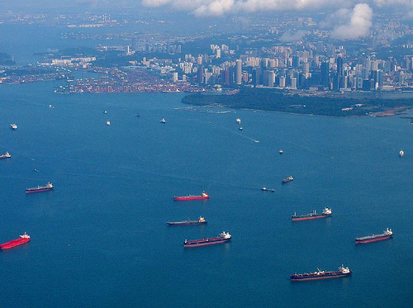

Slide 18
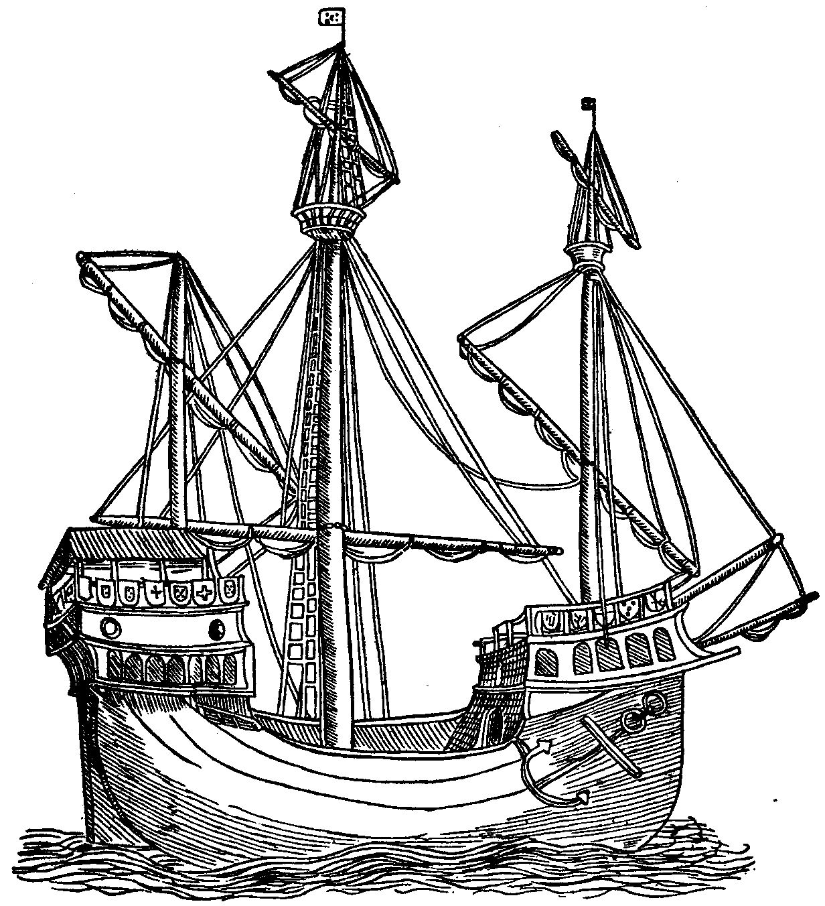
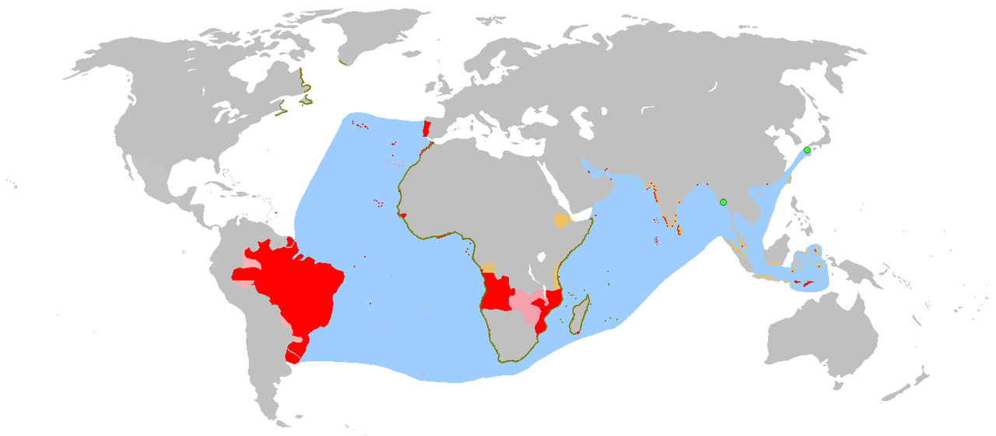
Portuguese colonial empire

Slide 19
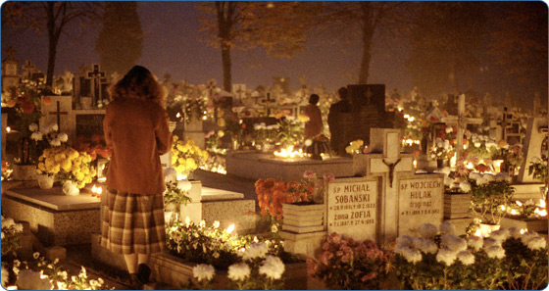
1755, All Saint’s Day (Nov 1), 9:40 AM

Slide 20
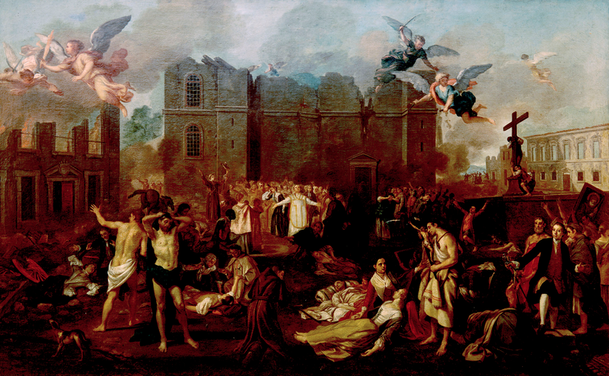
Allegory of the 1755 Earthquake, by João Glama Strobërle

Slide 21
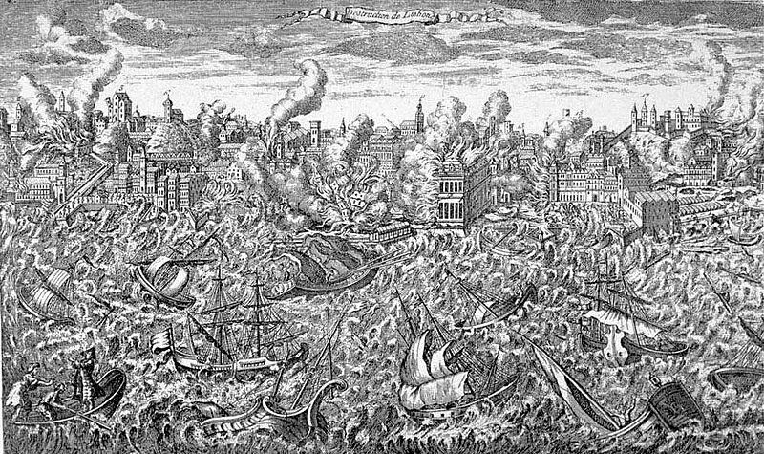

Slide 22
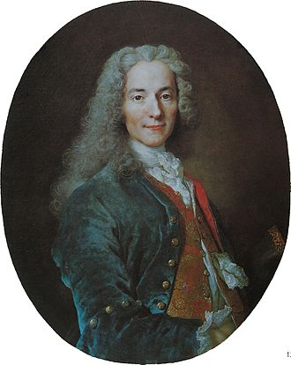
Voltaire
French Englightenment philosopher
1694-1778

Slide 23
“contemplate this ruin of a world”
What does Voltaire think about the theodicies I discussed above?
What does he think about the problem of evil?
Cite one passage from the “Poem on the Lisbon disaster” to support your answer.

Slide 24
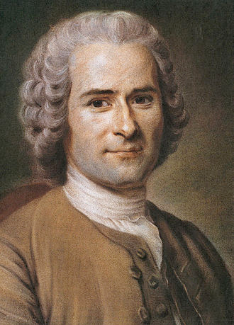
Rousseau
Another French Englightenment philosopher
1712-1778

Slide 25
Rousseau’s letter to Voltaire
Why does he disagree with Voltaire?
What is Rousseau’s view on the problem of evil?
Cite one passage from the letter to support your answer

Slide 26
What is the ‘scientific turn’ in Kant’s philosophy?
The beginning of “seismology”

Slide 27
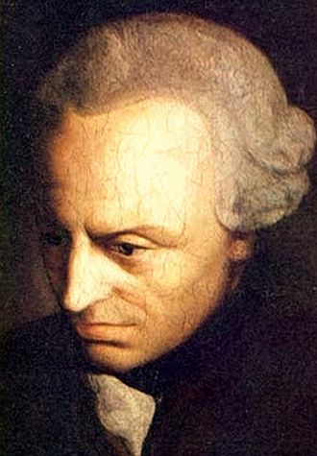
Immanuel Kant
German Enlightenment philosopher
What is the ‘scientific turn’ in Kant’s philosophy?
The beginning of “seismology”

Slide 28
Early Kant
Universe is developing, not fixed
Evidence for a Creator, despite existence of mechanical lawes
The world is “maturing”

Slide 29
Kant’s response to Lisbon
From providence to prognostication
Explanation and prevention
Toward responsibility

Slide 30
Kant, 1786
A presentation of the history of mankind must recommend to Man in order to serve him as a lesson and an improvement: that he must not blame providence in any way for the troubles that harm him; and also his own destruction cannot be ascribed to an original sin committed by his primitive parents; […] but that he recognizes every single event as if it in all respects were produced by himself, and that he therefore must accept himself the full responsibility for his own hardships, also those occasioned by abuse of reason.

